Slide 1
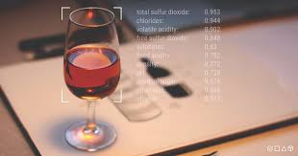
Wine Quality Prediction Analysis
Insights from Data Analysis and Model Comparison
By,
Aditya M
VVCE, Mysore

Slide 2
Project Overview
Objective:
The goal of this project is to analyze the physicochemical properties of red wine samples and predict their quality ratings using machine learning models.
Dataset:
This dataset contains 1,599 samples of red wine with 12 physicochemical properties and a quality rating on a scale from 0 to 10.
The features include aspects like acidity, sugar content, sulfur dioxide levels, alcohol, and more, which help assess the wine's quality.

Slide 3
Data Overview
Features:
Fixed Acidity, Volatile Acidity, Citric Acid, Residual Sugar, Chlorides, Free Sulfur Dioxide, Total Sulfur Dioxide, Density, pH, Sulphates, Alcohol.
Target Variable:
Quality: Integer ratings between 0 and 10, representing the perceived quality of wine.
Total Rows and Columns:
1,599 rows and 12 features plus the quality rating.
Dataset Insights:
Most wine samples have a quality rating between 5 and 6, with very few samples rated below 4 or above 8.

Slide 4
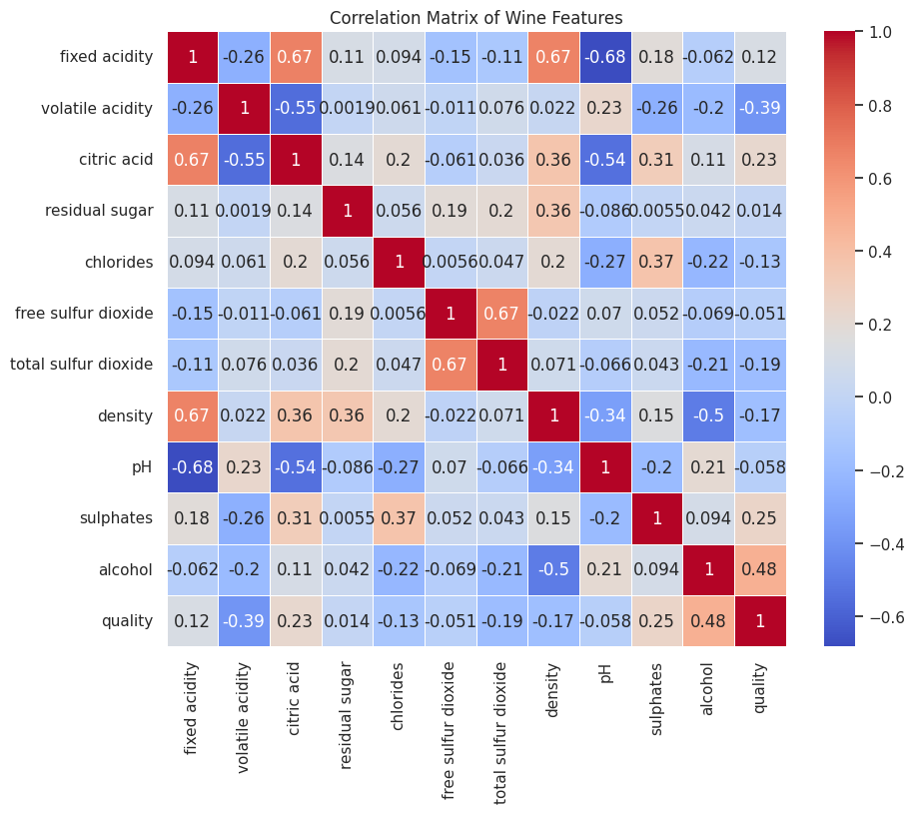
Exploratory Data Analysis (EDA)
Most Frequent Quality Score:
The most frequent quality rating is 5, indicating that most wines are of average quality.
Quality Range:
The dataset has wines with a quality rating ranging from 3 (lowest) to 8 (highest).
Visual Insight:
The heatmap reveals:
Strong positive correlations (e.g., alcohol with quality, 0.48).
Negative correlations (e.g., volatile acidity with quality, -0.39).
Low-impact features (e.g., residual sugar and fixed acidity with minimal correlation to quality).

Slide 5
Key Insights from Correlation Analysis
Alcohol Content:
Correlation with Quality: 0.48 (Positive correlation).
Higher alcohol content is generally associated with higher-quality ratings, possibly due to a richer flavor profile.
Volatile Acidity:
Correlation with Quality: -0.39 (Negative correlation).
Higher levels of volatile acidity tend to decrease wine quality, as excessive acetic acid can give the wine an unpleasant vinegary taste.
Citric Acid:
Correlation with Quality: 0.23 (Positive correlation).
Higher citric acid can enhance the freshness and perception of the wine.
Residual Sugar:
Correlation with Quality: 0.014 (Near-zero correlation).
Indicates that sugar levels are more about flavor balance rather than a direct quality indicator.
Free Sulfur Dioxide:
Correlation with Quality: -0.051 (Weak correlation).
Free sulfur dioxide is important for preservation but has a limited direct impact on quality.

Slide 6
Residual Sugar Insights
Average Residual Sugar for Best and Lowest Quality Wines:
Best Quality Wines (Quality = 8):
Average residual sugar is 2.60 g/L.
Lowest Quality Wines (Quality = 3):
Average residual sugar is 2.04 g/L.
Insight
Despite a slight difference, residual sugar does not play a major role in determining quality, as indicated by its low correlation (0.014).
This suggests that sugar levels primarily influence the sweetness and balance of flavors rather than directly impacting quality ratings.

Slide 7
Modeling Approach
Machine Learning Models:
Decision Tree Classifier:
Uses a tree-like model of decisions based on feature splits.
Easy to interpret but prone to overfitting.
Random Forest Classifier:
An ensemble of multiple decision trees to improve generalization.
Generally provides better accuracy by averaging predictions and reducing variance.
Data Preparation:
Data was split into 70% training and 30% testing sets.
Standard scaling was applied to normalize features, ensuring balanced input for the models.

Slide 8
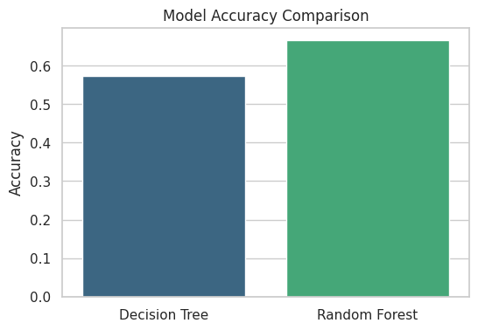
Model Performance Comparison
Decision Tree Classifier:
Accuracy: 59%
Confusion Matrix: Shows classification accuracy for each quality category.
Interpretation: The Decision Tree model has difficulty differentiating between closely rated wines, such as quality ratings of 5 and 6, leading to lower overall accuracy.
Random Forest Classifier:
Accuracy: 65%
Confusion Matrix: Provides better precision and recall compared to the Decision Tree model.
Interpretation: The Random Forest model, with its ensemble of trees, is more robust and effective in capturing complex relationships in the dataset, resulting in higher accuracy.
Visual Insight:
The bar chart illustrates that the Random Forest model significantly outperforms the Decision Tree, achieving an accuracy of 65% compared to 59%.
This improvement is due to Random Forest's ability to reduce overfitting by averaging the results of multiple decision trees.

Slide 9
Conclusion:
Random Forest is the preferred model for predicting wine quality as it provides better generalization and accuracy for this dataset.
Future improvements can focus on further tuning the Random Forest model or exploring more advanced models like Gradient Boosting for even higher accuracy.

